Slide 1


Unit Tests with PHP
Web Development with PHP
SUPINFO Official Document
Notes:
© SUPINFO International University - http://www.supinfo.com
SUPINFO vous permet de partager ce document
Vous êtes libre de :
Partager — reproduire, distribuer et communiquer ce document Remixer — modifier ce document
A condition de respecter les règles suivantes :
Indication obligatoire de la paternité — Vous devez obligatoirement préciser l’origine « SUPINFO » du document au début de celui-ci de la même manière qu’indiqué par SUPINFO International University – Notamment en laissant obligatoirement la première et la dernière page du document, mais pas d'une manière qui suggérerait que SUPINFO International University vous soutiennent ou approuvent votre utilisation du document, surtout si vous le modifiez. Dans ce dernier cas, il vous faudra obligatoirement supprimer le texte « SUPINFO Official Document » en tête de page et préciser notamment la page indiquant votre identité et les modifications principales apportées.
En dehors de ces dispositions, aucune autre modification de la première et de la dernière page du document n’est autorisée.
NOTE IMPORTANTE : Ce document est mis à disposition selon le contrat CC-BY-NC-SA Creative Commons disponible en ligne http://creativecommons.org/licenses ou par courrier postal à Creative Commons, 171 Second Street, Suite 300, San Francisco, California 94105, USA modifié en ce sens que la première et la dernière page du document ne peuvent être supprimées en cas de reproduction, distribution, communication ou modification. Vous pouvez donc reproduire, remixer, arranger et adapter ce document à des fins non commerciales tant que vous respectez les règles de paternité et que les nouveaux documents sont protégés selon des termes identiques. Les autorisations au-delà du champ de cette licence peuvent être obtenues à support@supinfo.com.
© SUPINFO International University – EDUCINVEST - Rue Ducale, 29 - 1000 Brussels Belgium . www.supinfo.com

Slide 2

Objectives
Unit Tests with PHP
By completing this course, you’ll be able to:
Understand Test Driven Development
Explain what is PHP Unit
Develop tests with PHP Unit

Slide 3


Course plan
Unit Tests with PHP
Introduction
What is PHPUnit?
Syntax
Test your tests!

Slide 4

Introduction
Unit Tests with PHP

Slide 5

What are Unit Tests?
Introduction
“The purpose of a unit test is to give a developer confidence that a particular part of their application behaves in the way that the developer expects.”
– Stephen Walther

Slide 6
What are Unit Tests?
Introduction
Tests:
Ensures your application work the way you want
Add consistency to your application
Unit:
Create tests in smallest & modular units
Usually test directly classes

Slide 7
Why use Unit Tests?
Introduction
Stops code regression
After changing some part of your code, just run the tests to be sure nothing is broken
Code verified twice
Your code could be buggy. Your tests could be buggy. But there’s a small chance both are buggy!
Live documentation
Read tests is simple. It gives you many information of how the web application works
Notes:
http://stackoverflow.com/questions/67299/is-unit-testing-worth-the-effort
http://geekswithblogs.net/jboyer/archive/2011/09/07/5-reasons-why-unit-testing-is-funndashand-important.aspx

Slide 8
When to use Unit Tests?
Introduction
“Whenever you are tempted to type something into a print statement or a debugger expression, write it as a test instead”
– Martin Fowler

Slide 9
When to use Unit Tests?
Introduction
Before or while writing code
Write tests after can lead to a waste of time
Be careful: Unit Tests is a lot of work
Might not be suited to small projects
If you want a project easy to read and without bugs…
…Always then ☺

Slide 10
Unit Tests everywhere
Introduction
JavaScript: Jasmine
PHP : PHPUnit
Java: JUnit
C#: NUnit
Ruby: In standard library
Python: unittest
…

Slide 11
Test-Driven Development (TDD)
Introduction
A project management method
Based on Unit Tests
Write unit tests before the development
Saves time
Live documentation
Develop the project step by step

Slide 12
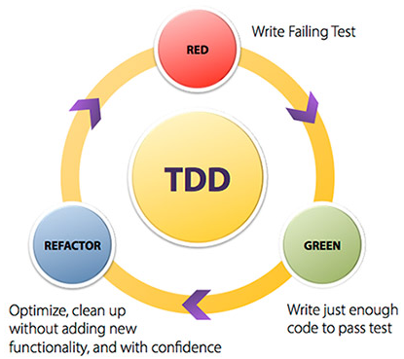
TDD
Introduction
Red-Green-Refactor principle
© http://centricconsulting.com
Notes:
Image source: http://centricconsulting.com/case-studies/agile-test-driven-development/
FR: http://bruno-orsier.developpez.com/tutoriels/TDD/pentaminos/
Books:
http://www.amazon.fr/Test-Driven-Development-Example-Kent-Beck/dp/0321146530/ref=sr_1_20/403-0522420-1320461?ie=UTF8&s=english-books&qid=1177932045&sr=8-20
http://www.amazon.com/Art-Unit-Testing-Examples-Net/dp/1933988274/ref=sr_1_1?s=books&ie=UTF8&qid=1315368801&sr=1-1

Slide 13


Questions?

Slide 14
PHPUnit
Unit Tests with PHP
Notes:
Book:
http://shop.oreilly.com/product/9780596101039.do

Slide 15
What is PHPUnit?
PHPUnit
Developed by Sebastian Bergmann
Open source: Available on GitHub
Current major version: 4.x
Downloadable by ZIP, PHAR or Composer
Notes:
PHAR = PHP Archive (like JARs for Java)
Sebastien Bergmann website & publications: https://sebastian-bergmann.de/publications.html

Slide 16
What is PHPUnit?
PHPUnit
Based on assertions
I will assert that:
Based on how I call the method
Considering which arguments I send to
The result must be what you think about

Slide 17
Simple example – MathClass
PHPUnit
class MathClass {
public static function add($number1, $number2) {
return $number1 + $number2;
}
}

Slide 18
Simple example – MathClassTest
PHPUnit
require("MathClass.php");
class MathClassTest extends PHPUnit_Framework_TestCase {
public function testAdd() {
// Check with positive numbers
$this->assertEquals(MathClass::add(2, 3), 5);
// Check with zero values
$this->assertEquals(MathClass::add(0, 0), 0);
// Check with negative values
$this->assertEquals(MathClass::add(-2, 3), 1);
// Check with float values
$this->assertEquals(MathClass::add(2.3, 3.5), 5.8);
}
}

Slide 19
Installation
PHPUnit
Download the PHAR file at:
https://phar.phpunit.de/phpunit.phar
To execute a test, use your terminal/cmd:
localhost:MyProjectFolder user$ phpunit.phar MathClassTest.php

Slide 20
Execution
PHPUnit
You can execute all unit tests in a folder:
By default, PHPUnit considers as test every file ending with: …Test.php
Every test function starts with “test”
You can override this with a phpunit.xml file
localhost:MyProjectFolder user$ phpunit.phar Tests/
Notes:
More information about phpunit.xml on the documentation

Slide 21
Questions?

Slide 22

Exercise (1/2)
PHPUnit
Download and use PHPUnit
Create a “CurrencyClass” class
Private prependCurrencySymbol($currency, $amount)
Should return your currency symbol then your amount
Private appendCurrencySymbol($currency, $amount)
Should return your amount then your currency symbol
Public formatWithCurrency($currency, $amount)
Should call one of prepend or append function according to the currency

Slide 23
Exercise (2/2)
PHPUnit
Your formatWithCurrency function should:
Prepend with “$” and “£” symbols
Append with “€” symbol
Create your test and see if it works!

Slide 24
PHPUnit tests
Unit Tests with PHP

Slide 25
Assertions
PHPUnit Tests
Many assertions available:
assertArrayHasKey
assertContains
assertEmpty
assertFalse
assertFileExists
assertGreaterThan
Check the documentation for a complete list!
assertInstanceOf
assertNull
assertRegExp
assertStringEndsWith
assertThat

Slide 26
assertArrayHasKey
PHPUnit Tests
class SimpleTest extends PHPUnit_Framework_TestCase {
public function testArrayHasKeySuccess () {
$array = array(7, 8, 9);
$this->assertArrayHasKey(2, $array); // True
}
public function testArrayHasKeyFail() {
$array2 = array("name" => "John", "foo" => "bar");
$this->assertArrayHasKey("bar", $array2); // False
}
}
.F
There was 1 failure:
1) SimpleTest::testArrayHasKeyFail
Failed asserting that an array has the key 'bar’.

Slide 27
assertContains
PHPUnit Tests
class SimpleTest extends PHPUnit_Framework_TestCase {
public function testArrayContainsSuccess () {
$array = array(7, 8, 9);
$this->assertContains(7, $array); // True
}
public function testArrayContainsFail() {
$array2 = array("name" => "John", "foo" => "bar");
$this->assertcontains("baz", $array2); // False
}
}
.F
There was 1 failure:
1) SimpleTest::testArrayContainsFail
Failed asserting that an array contains 'baz'.

Slide 28
assertFileExists
PHPUnit Tests
class SimpleTest extends PHPUnit_Framework_TestCase {
public function testFileExists () {
$this->assertFileExists('path/to/my/file'); // False
}
}
F
There was 1 failure:
1) SimpleTest::testFileExists
Failed asserting that file "path/to/my/file" exists.

Slide 29
assertInstanceOf
PHPUnit Tests
class A {}
class B extends A {}
class SimpleTest extends PHPUnit_Framework_TestCase {
public function testInstanceOfSuccess() {
$this->assertInstanceOf('A', new B()); // True
}
public function testInstanceOfFail() {
$this->assertInstanceOf('B', new A()); // False
}
}
.F
There was 1 failure:
1) SimpleTest::testInstanceOfFail
Failed asserting that A Object () is an instance of class "B".

Slide 30
assertRegExp
PHPUnit Tests
class SimpleTest extends PHPUnit_Framework_TestCase {
public function testRegExpSuccess() {
$this->assertRegExp('/hello/', 'hello world'); // True
}
public function testRegExpFail() {
$this->assertRegExp('/hello/', 'world'); // False
}
}
.F
There was 1 failure:
1) SimpleTest::testRegExpFail
Failed asserting that 'world' matches PCRE pattern "/hello/".

Slide 31
assertThat
PHPUnit Tests
class SimpleTest extends PHPUnit_Framework_TestCase {
public function testThat() {
$oneString = "hello";
$anotherString = "world";
$this->assertThat(
$oneString,
$this->logicalNot(
$this->equalTo($anotherString)
)
);
}
}
What will be the output?
Notes:
Success
This test checks that hello is not equal to world

Slide 32
assertThat – Level 2
PHPUnit Tests
class SimpleTest extends PHPUnit_Framework_TestCase {
public function testThat() {
$this->assertThat(
"Kevin",
$this->logicalAnd(
$this->isType("string"),
$this->logicalNot($this->equalTo("")),
$this->logicalAnd(
$this->logicalNot($this->equalTo("John")),
$this->logicalNot($this->equalTo("Mary"))
)
)
);
}
}
What will be the output? Which strings will work?
Notes:
Success
This test checks that « Kevin » is a string, is not empty, and is neither equal to John nor Mary

Slide 33
Annotations
PHPUnit Tests
Some annotations available:
@before/@after
@dataProvider
@depends
@expectedException
@test
Check the documentation for a complete list!

Slide 34
@before/@after
PHPUnit Tests
Not a test. Will be executed before/after each test
class SimpleTest extends PHPUnit_Framework_TestCase { private $object;
/**
* @before
*/
public function initializeObject() {
$this->object = new stdClass();
}
public function testObject() {
$this->assertNotNull($this->object); // True
}
}

Slide 35
@dataProvider
PHPUnit Tests
Not a test. Send data to a test
class SimpleTest extends PHPUnit_Framework_TestCase {
/**
* @dataProvider stringProvider
*/
public function testConcat($string1, $string2, $expected) {
$this->assertEquals($expected, $string1 . $string2);
}
public function stringProvider() {
return array(
array("hello", "world", "helloworld"),
array("goodbye", "world", "goodbyeworld")
);
}
}

Slide 36
@depends
PHPUnit Tests
A test that needs another test
class SimpleTest extends PHPUnit_Framework_TestCase {
public function testEmpty() {
$array = array();
$this->assertEmpty($array);
return $array;
}
/**
* @depends testEmpty
*/
public function testAdd(array $array) {
array_push($array, 2209);
$this->assertContains(2209, $array);
}
}
Notes:
If testEmpty fails, testAdd will be skipped

Slide 37
@expectedException
PHPUnit Tests
A test that must throw a specific Exception
class SimpleTest extends PHPUnit_Framework_TestCase {
/**
* @expectedException PDOException
*/
public function testBadQuery() {
$db = new PDO("mysql:host=localhost;dbname=example",
"root", "root",
array(PDO::ATTR_ERRMODE => PDO::ERRMODE_EXCEPTION));
$db->query("SELECT FROM"); // Obvious syntax error
$this->fail(); // An exception must have been thrown before
}
}

Slide 38
@test
PHPUnit Tests
No matter its name, this function is a test
class SimpleTest extends PHPUnit_Framework_TestCase {
/**
* @test
*/
public function notStartingByTest() {
$this->assertTrue(true);
}
}

Slide 39
Questions?

Slide 40
Exercise (1/2)
PHPUnit Tests
Refactor your PHPBlog application
Add tests for all classes
Be careful while writing your tests:
All tests should be a success
if the test is meant to pass, it should obviously pass
If it’s meant to fail, use assertation/annotation to explain this failure is in fact a success
Notes:
If it’s meant to fail, use assertation/annotation to explain this failure is in fact a success
For example the use of expectedException, or $this->assertNotEquals, $this->assertNotEmpty, $this->assertFalse…
$this->fail() should be used only if something gets wrong

Slide 41
Exercise (2/2)
PHPUnit Tests
Refactor your PHPBlog application
Add tests for all classes
Use DataProviders and Depends annotations to create test series
Don’t Repeat Yourself!
Notes:
If it’s meant to fail, use assertation/annotation to explain this failure is in fact a success
For example the use of expectedException, or $this->assertNotEquals, $this->assertNotEmpty, $this->assertFalse…
$this->fail() should be used only if something gets wrong

Slide 42

NetBeans Integration
Unit Tests with PHP

Slide 43
Create Tests Folder
NetBeans Integration
Right click on the “Source Files”
“Tools” Option
“Create Tests”
OR
Right click on the Project folder
“Test”

Slide 44
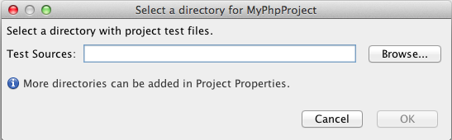
Create Tests Folder
NetBeans Integration
It will display this message box:

Slide 45
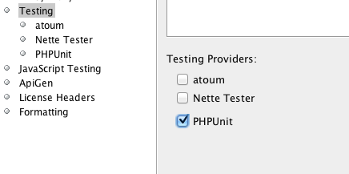
Create Tests Folder
NetBeans Integration
After folder creation, tick the “PHPUnit” box:

Slide 46
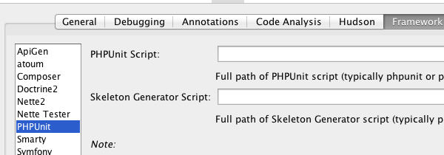
Link PHPUnit PHAR file
NetBeans Integration
Finally, NetBeans Options tab:

Slide 47
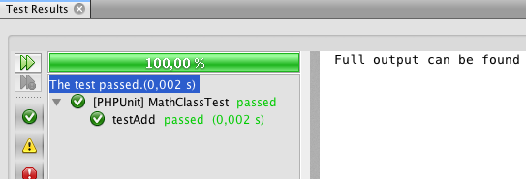
NetBeans window
NetBeans Integration
Right-click “Test” on your project!

Slide 48
Questions?

Slide 49
Exercise
NetBeans Integration
Integrate PHPUnit in NetBeans for your blog project!
Finish writing Unit Tests for your PHPBlog

Slide 50

The End
Unit Tests with PHP
That’s all folks!

